Slide 1

Inventory Management System

Slide 2

C480 Software Development Capstone

Slide 3
Team Members:
Front-End Team
Back-End Team
Delia Compton
Lisa Cuellar
Trainmon Harrison
Zachary Person
Lamont Venson
Miguel Bernal
Jeffrey Chaplin
Tash Robinson
Jacob Ryan

Slide 4
Goals:
Create an inventory system that has an easy navigation system where the admin can input his own custom inventory and employees can view the data using product lists, supply lists to view the location and price of the products.
Utilizing security features like an SSL Certificate for additional hardening and internet security will allows users to feel safe when using our interface to help them keep track of their inventory systems.

Slide 5



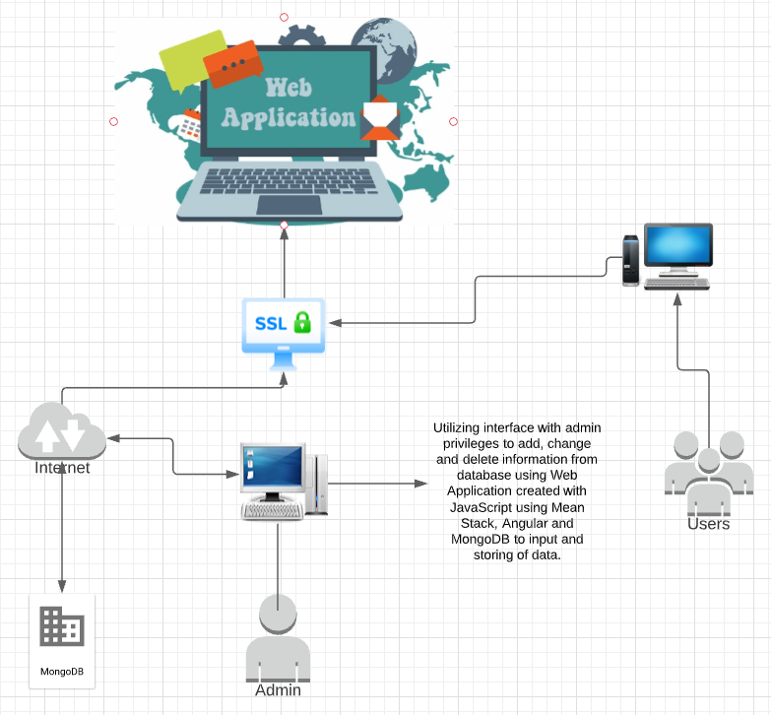
Project Diagram:

Slide 6

Team Member Contributions:

Slide 7
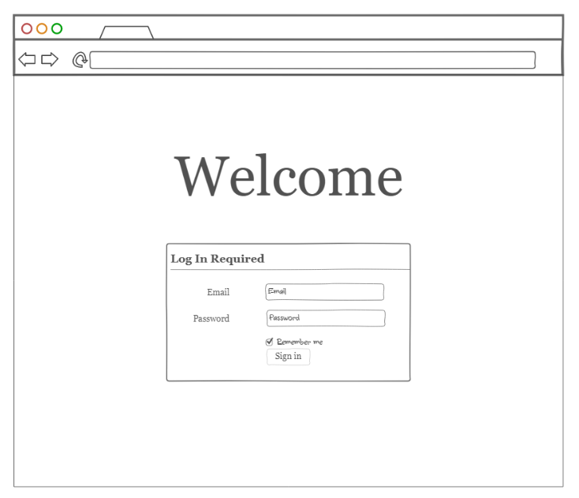
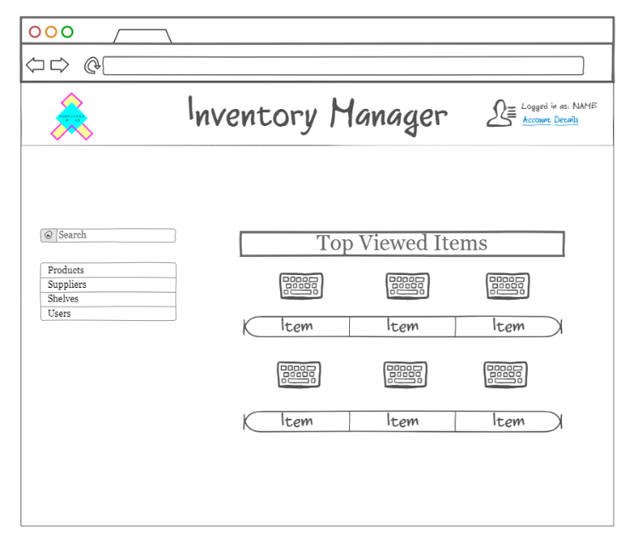
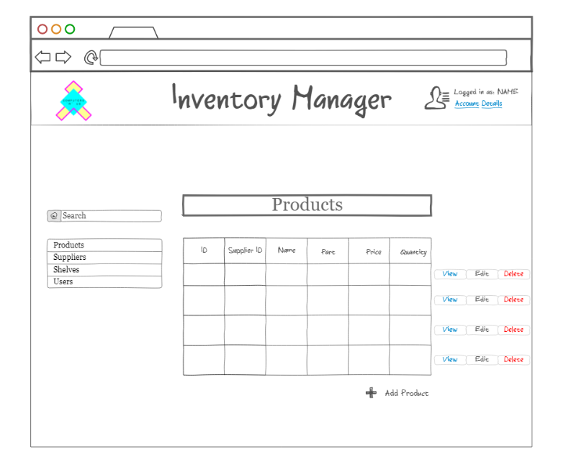
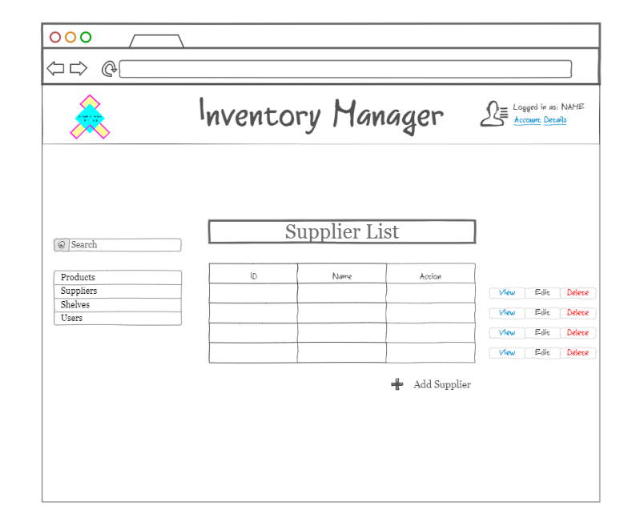
Delia Compton
Main contribution to the project was creating the wireframe and overall design of our website. She utilized NinjaMock to create the wireframe. She also help decide on the aesthetics and front-end details and features throughout the project.

Slide 8
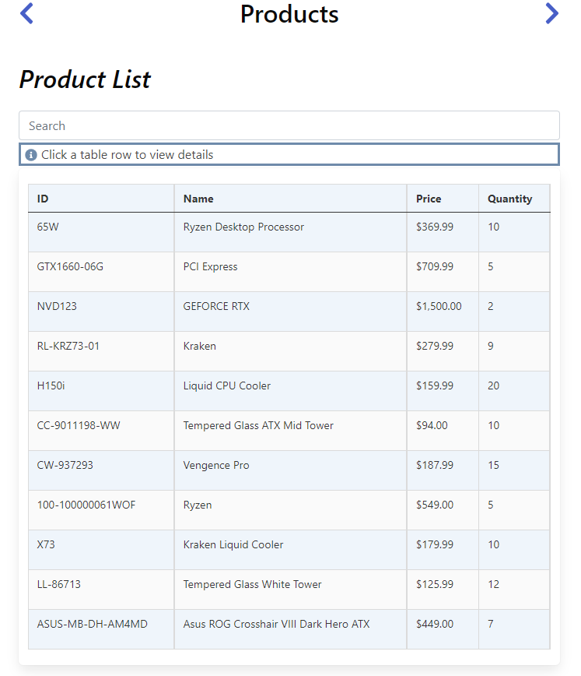

Lisa Cuellar
Filled Products list database
Helped with look and color scheme of buttons
Front end design
Suggestions to different UI design changes

Slide 9
Trainmon Harrison
Brainstormed ideas with the front-end team
Gave feedback when the group was presented with a suggestion

Slide 10
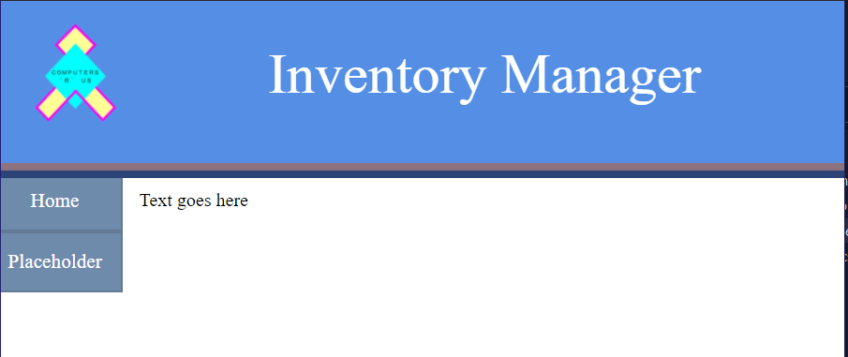
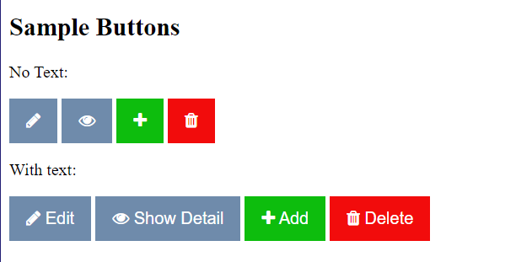
Zachary Person
Contributed to the project by designing the initial prototypes for the GUI (Graphical User Interface) design.
This included design elements such as the
Buttons
Header
Navigation Bar
Top: Initial prototype for our header. Bottom: Prototypes for buttons.

Slide 11
Lamont Venson
Helped with back-end
Contributed to group discussions about back-end development

Slide 12
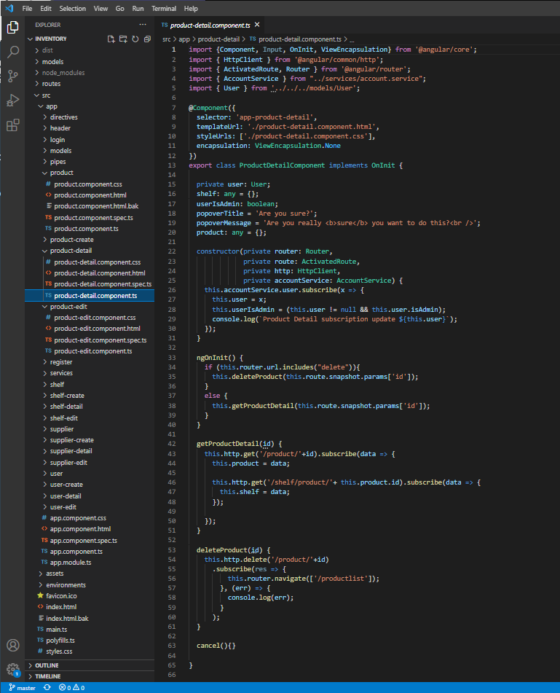
Miguel Bernal:
Worked with back-end team members to transition the supply and product detail and list to show up when selecting the detail on each product.
Research on how to fix minor bugs for .js and .ts files.
Created foundation for PowerPoint presentation.

Slide 13
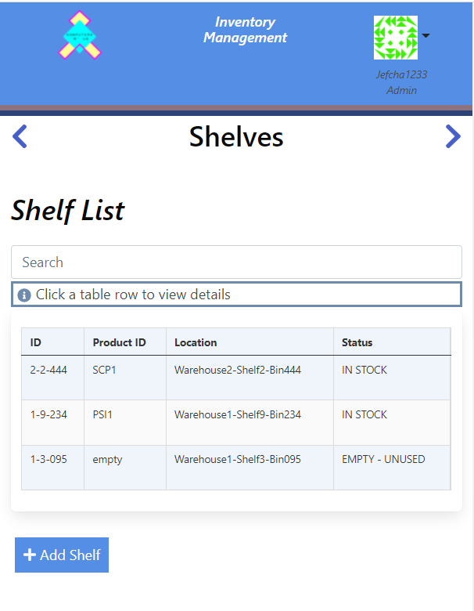
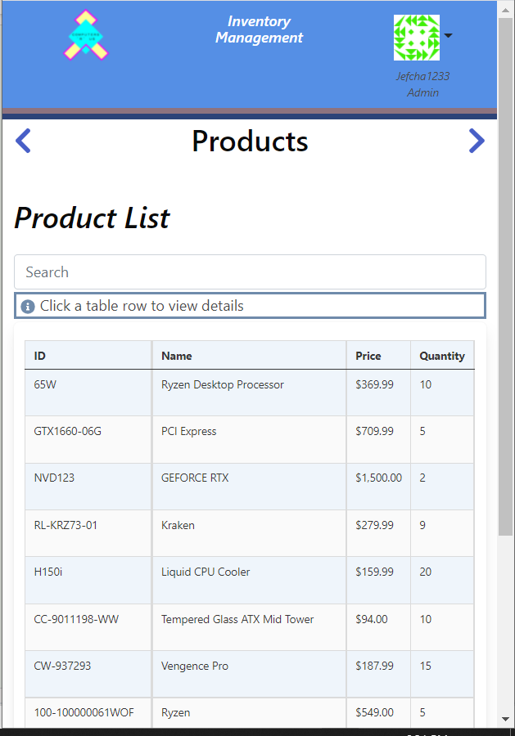
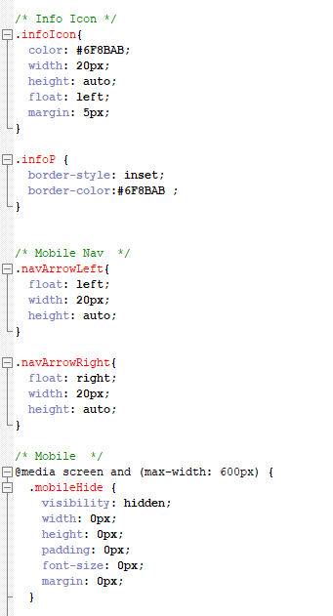
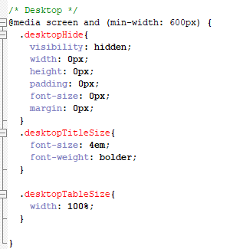
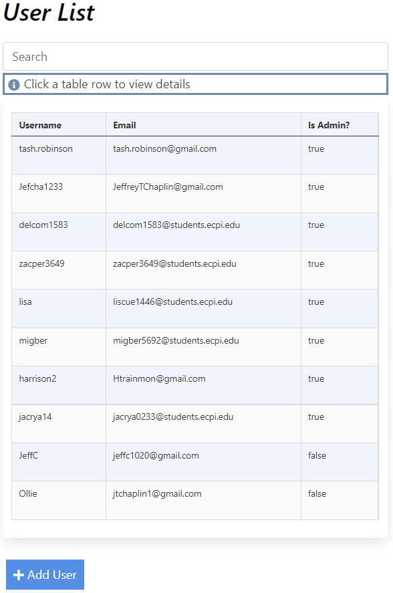
Jeff Chaplin:
Contributions:
Mobile Formatting
Assisted with GUI design via Wireframe
Assisted in implementation of GUI

Slide 14

Tash Robinson
Laid the groundwork for the front and back end of the application, including CRUD operations.
Set up GitHub and digital ocean hosting

Slide 15
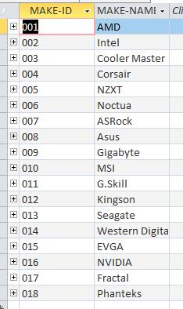
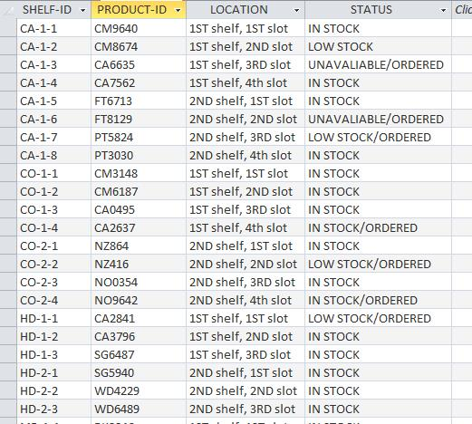
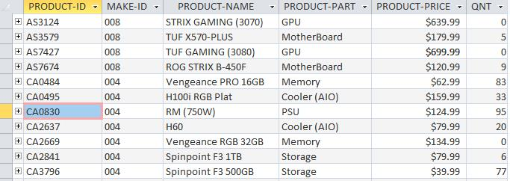
Jacob Ryan
Suggested the overall concept of the project of making an inventory management database.
Suppled example screen shots of the 'Suppler Table', 'Location Table', and the 'Product Table'.
Organized the teams on who will be working on 'Front End' and who would be working on 'Back End'.

Slide 16

Web Application Screenshots

Slide 17

URL
https://cap480inventoryman.com
Github – source code: https://github.com/tashrobinson/inventory-manager

Slide 18
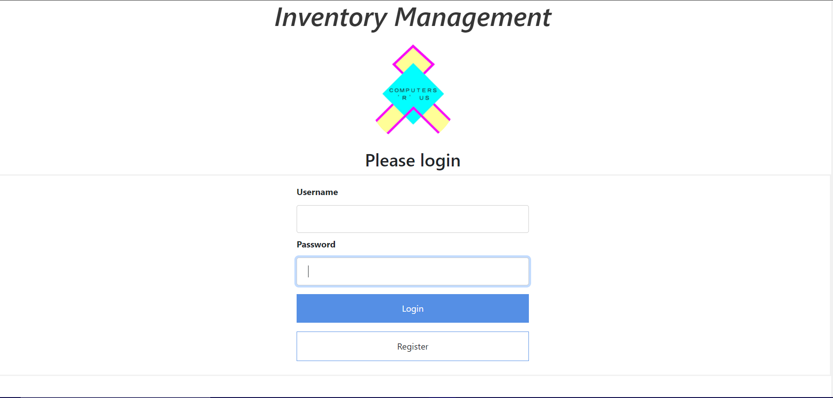
Login

Slide 19
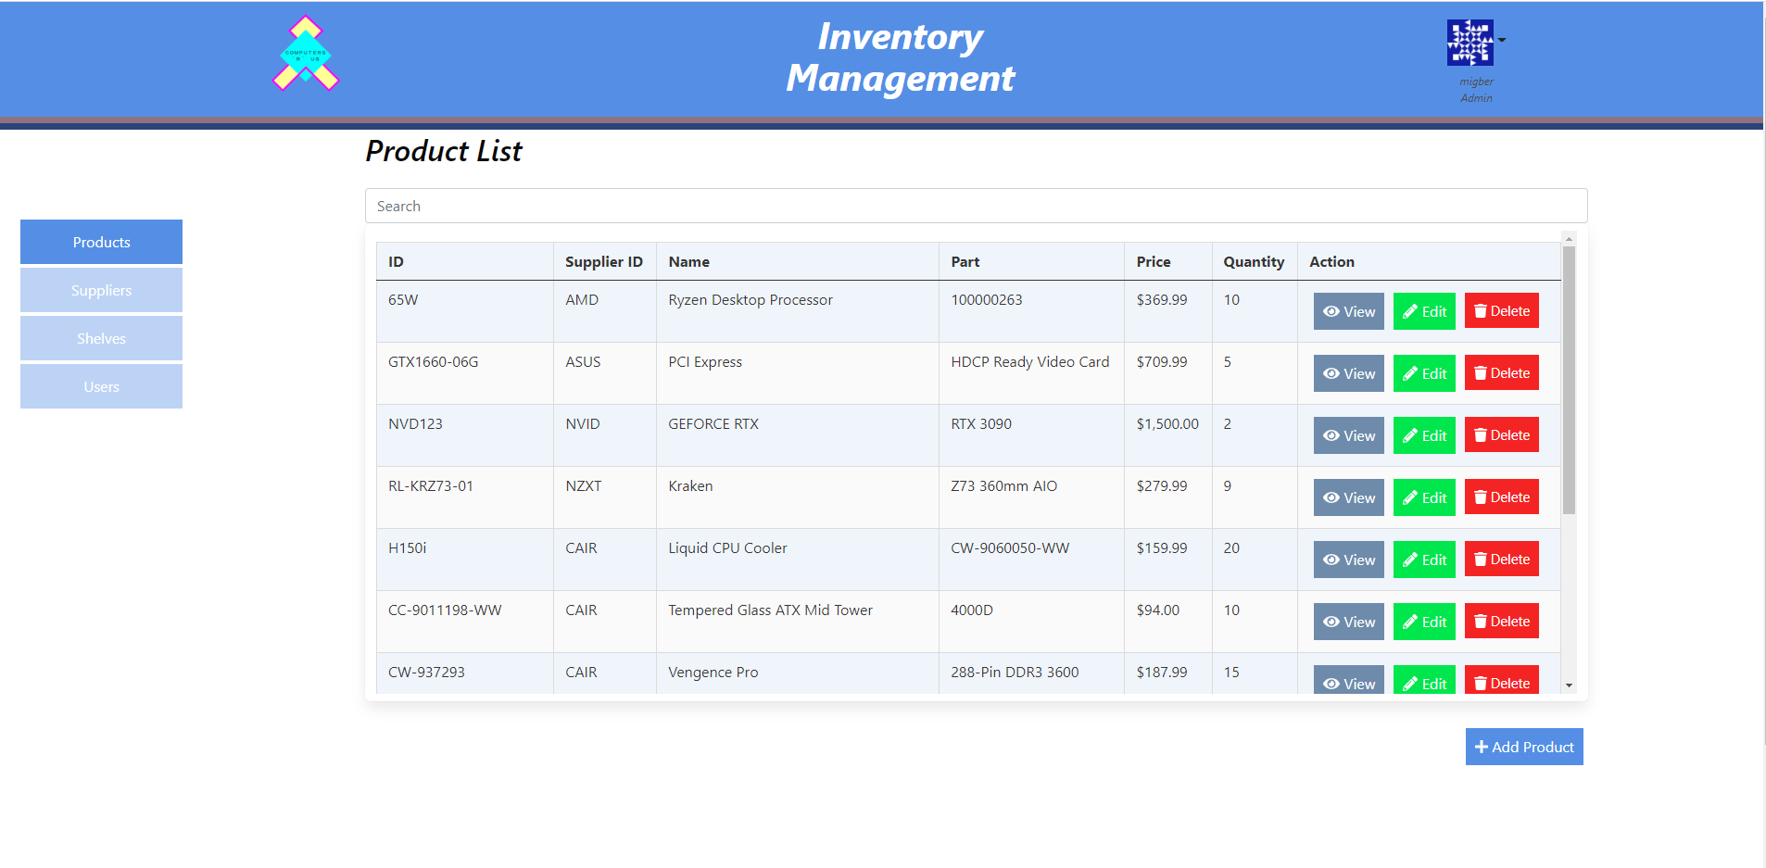
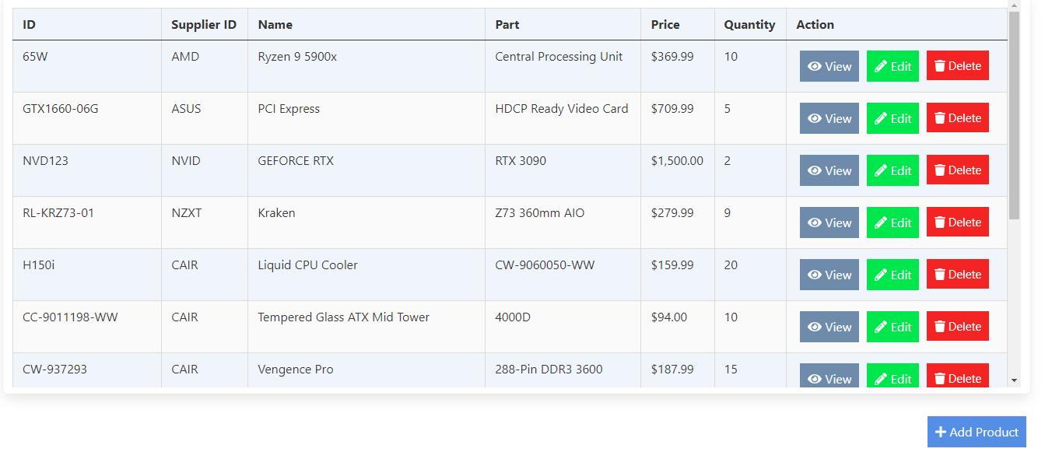
Product List

Slide 20
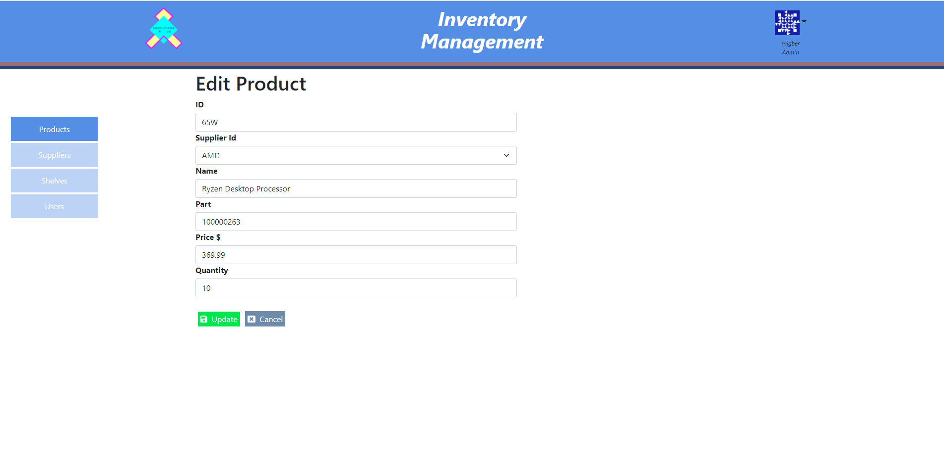
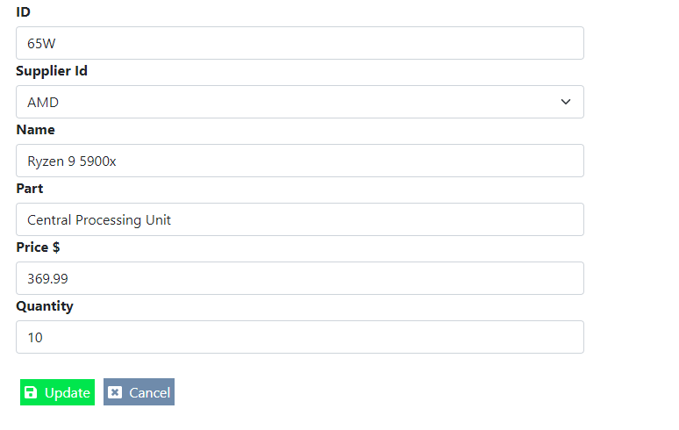
Product Edit

Slide 21
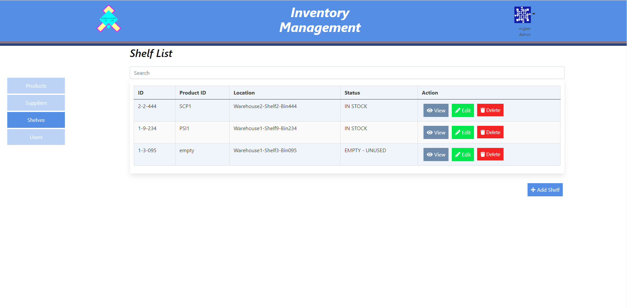
Shelf List

Slide 22
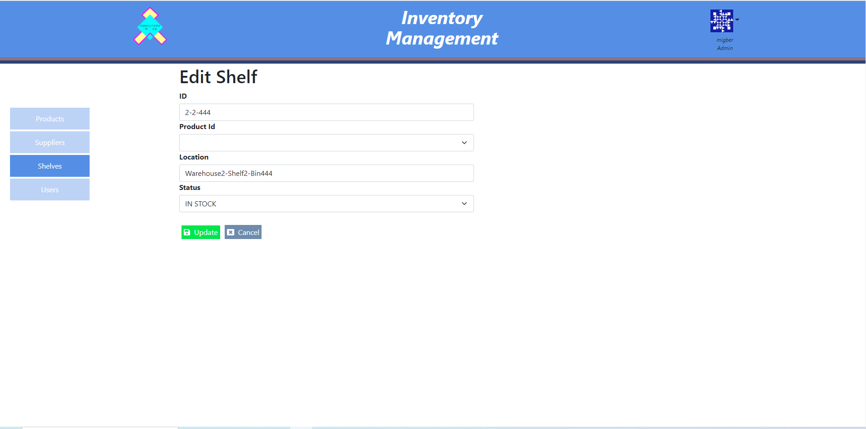
Shelf Edit

Slide 23
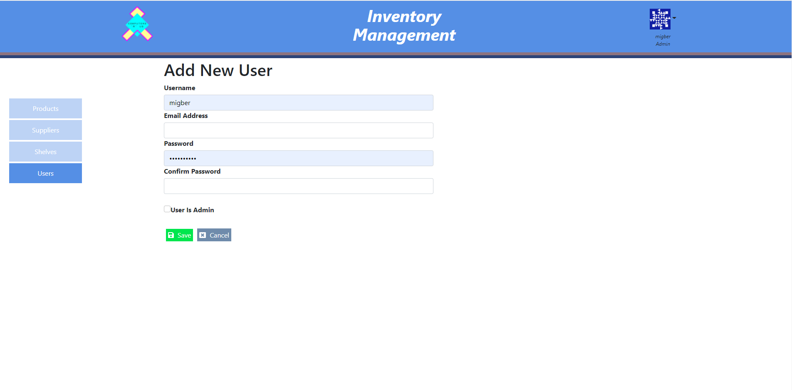
User Edit

Slide 24
Future Improvements:
Introducing images for the products for a visual representation of the inventory available for the user.
Use an OAuth authorization service to be more secure and allow Google or Facebook logins.
Possibly a demo or shop that shows the products and allows pulling from inventory.

Slide 25
Conclusion:
Overall positive experience with the entire group and product.
Focused on what was more important to get completed in the allotted time.
Distribution of roles were spread out evenly among the team member in order to reach our weekly goal.
Final product finished prior to the deadline and is working as intended.
Consistent communication between both Front and Back teams to ensure project goals were met in an orderly fashion to meet project deadline.

